Slide 1
Module 6.2 Cross Site Request Forgery
CSRF

Slide 2
OWASP Top Ten (2013)
A-1 | Injection | Untrusted data is sent to an interpreter as part of a command or query.
A-2 | Authentication and Session Management | Attacks passwords, keys, or session tokens, or exploit other implementation flaws to assume other users’ identities.
A-3 | Cross-site scripting | An application takes untrusted data and sends it to a web browser without proper validation or escaping
… | Various implementation problems | …expose a file, directory, or database key without access control check, …misconfiguration, …missing function-level access control
A-8 | Cross-site request forgery | A logged-on victim’s browser sends a forged HTTP request, including the victim’s session cookie and other authentication information
https://www.owasp.org/index.php/Top_10_2013-Top_10

Slide 3
Recall: session using cookies
Browser
Server
POST/login.cgi
Set-cookie: authenticator
GET…
Cookie: authenticator
response

Slide 4
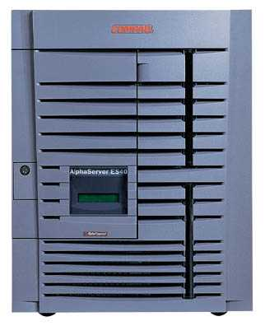
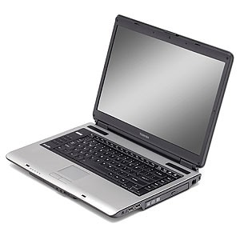
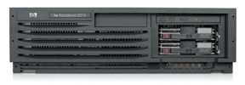
Basic picture
Server Victim
establish session
1
send forged request
4
(w/ cookie)
2
User Victim
3
visit server (or iframe)
receive malicious page
Attack Server
Q: how long do you stay logged in to Gmail? Facebook? ….

Slide 5
Cross Site Request Forgery (CSRF)
Example:
User logs in to bank.com
Session cookie remains in browser state
User visits another site containing:
<form name=F action=http://bank.com/BillPay.php>
<input name=recipient value=badguy> …
<script> document.F.submit(); </script>
Browser sends user auth cookie with request
Transaction will be fulfilled
Problem:
cookie auth is insufficient when side effects occur

Slide 6
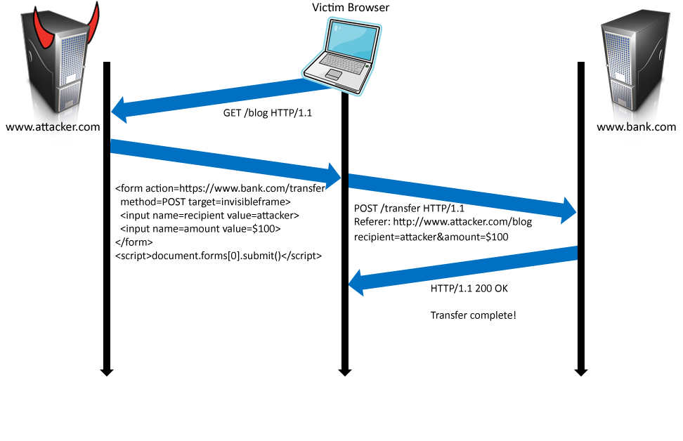
Form post with cookie
Cookie: SessionID=523FA4cd2E
User credentials

Slide 7
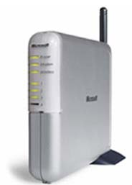
Cookieless Example: Home Router
Home router
configure router
1
send forged request
4
2
visit site
3
User
Bad web site
receive malicious page

Slide 8
Attack on Home Router
[SRJ’07]
Fact:
50% of home users have broadband router with a default or no password
Drive-by Pharming attack: User visits malicious site
JavaScript at site scans home network looking for broadband router:
SOP allows “send only” messages
Detect success using onerror:
<IMG SRC=192.168.0.1 onError = do() >
Once found, login to router and change DNS server
Problem: “send-only” access sufficient to reprogram router

Slide 9




CSRF Defenses
Secret Validation Token
Referer Validation
Custom HTTP Header
<input type=hidden value=23a3af01b>
Referer: http://www.facebook.com/home.php
X-Requested-By: XMLHttpRequest

Slide 10
Secret Token Validation
Requests include a hard-to-guess secret
Unguessability substitutes for unforgeability
Variations
Session identifier
Session-independent token
Session-dependent token
HMAC of session identifier

Slide 11
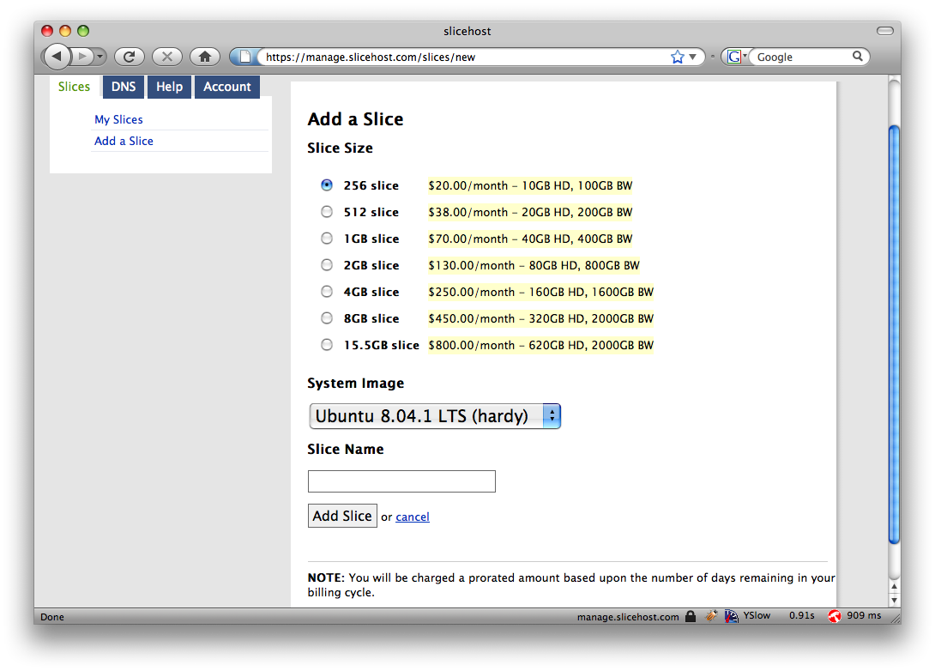
Secret Token Validation

Slide 12
Referer Validation

Slide 13
Referer Validation Defense
HTTP Referer header
Referer: http://www.facebook.com/
Referer: http://www.attacker.com/evil.html
Referer:
Lenient Referer validation
Doesn't work if Referer is missing
Strict Referer validaton
Secure, but Referer is sometimes absent…
✓
✗
?

Slide 14
Referer Privacy Problems
Referer may leak privacy-sensitive information
http://intranet.corp.apple.com/
projects/iphone/competitors.html
Common sources of blocking:
Network stripping by the organization
Network stripping by local machine
Stripped by browser for HTTPS -> HTTP transitions
User preference in browser
Buggy user agents
Site cannot afford to block these users

Slide 15
Suppression over HTTPS is low

Slide 16
Custom Header Defense
XMLHttpRequest is for same-origin requests
Can use setRequestHeader within origin
Limitations on data export format
No setRequestHeader equivalent
XHR2 has a whitelist for cross-site requests
Issue POST requests via AJAX:
Doesn't work across domains
X-Requested-By: XMLHttpRequest

Slide 17
Broader view of CSRF
Abuse of cross-site data export feature
From user’s browser to honest server
Disrupts integrity of user’s session
Why mount a CSRF attack?
Network connectivity
Read browser state
Write browser state
Not just “session riding”

Slide 18
Login CSRF
Notes:
Today I came across an academic paper which gives three examples of why Login CSRF can be an issue and how wrong I was.
Google
“Search History. Many search engines, including Yahoo! and Google, allow their users to opt-in to saving their search history and provide an interface for a user to review his or her personal search history. Search queries contain sensitive details about the user’s interests and activities [41, 4] and could be used by an attacker to embarrass the user, to steal the user’s identity, or to spy on the user. An attacker can spy on a user’s search history by logging the user into the search engine as the attacker; see Figure 1. The user’s search queries are then stored in the attacker’s search history, and the attacker can retrieve the queries by logging into his or her own account.”
PayPal
“PayPal. PayPal lets its users transfer funds to each other. To fund a PayPal account, users enroll their credit card or their bank account. A web attacker can use login CSRF to mount the following attack:
1. The victim visits a malicious merchant’s site and chooses to pay using PayPal.
2. As usual, victim is redirected to PayPal and logs into his or her account.
3. The merchant silently logs the victim into his or her PayPal account.
4. To fund her purchase, the victim enrolls his or her credit card, but the credit card has actually been added to the merchant’s PayPal account.”
iGoogle
“iGoogle. Using iGoogle, users can customize their Google homepage by including gadgets. For usability, some gadgets are “inline,” meaning they run in the security context of iGoogle. Before adding such gadgets, users are asked to make a trust decision, but in a login CSRF attack, a web attacker makes the trust decision on behalf of the user:
1. Using his or her own browser, the attacker authors an inline iGoogle gadget (containing a malicious script) and adds it to his or her own personalized home page.
2. The attacker logs the victim into Google as the attacker and opens a frame to iGoogle.
3. Google believes the victim to be the attacker and serves the attacker’s gadget to the victim, letting the attacker to run script in the https://www.google.com origin.
4. The attacker can now either (a) create a fake login page at the correct URL, (b) steal the user’s autocompleted password, or (c) wait for the user to log in using another window and read document.cookie.”

Slide 19
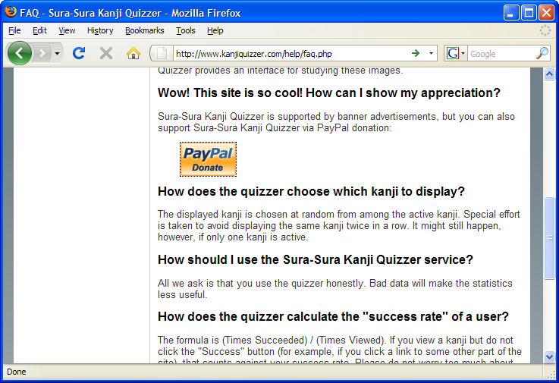
Payments Login CSRF

Slide 20
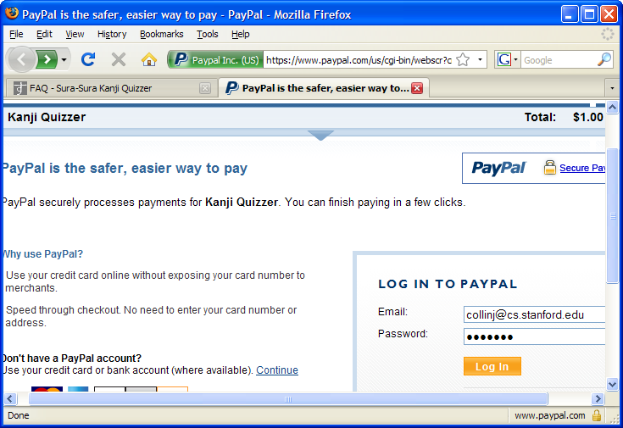
Payments Login CSRF

Slide 21
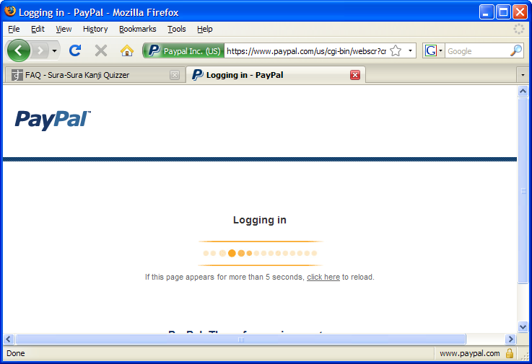
Payments Login CSRF

Slide 22
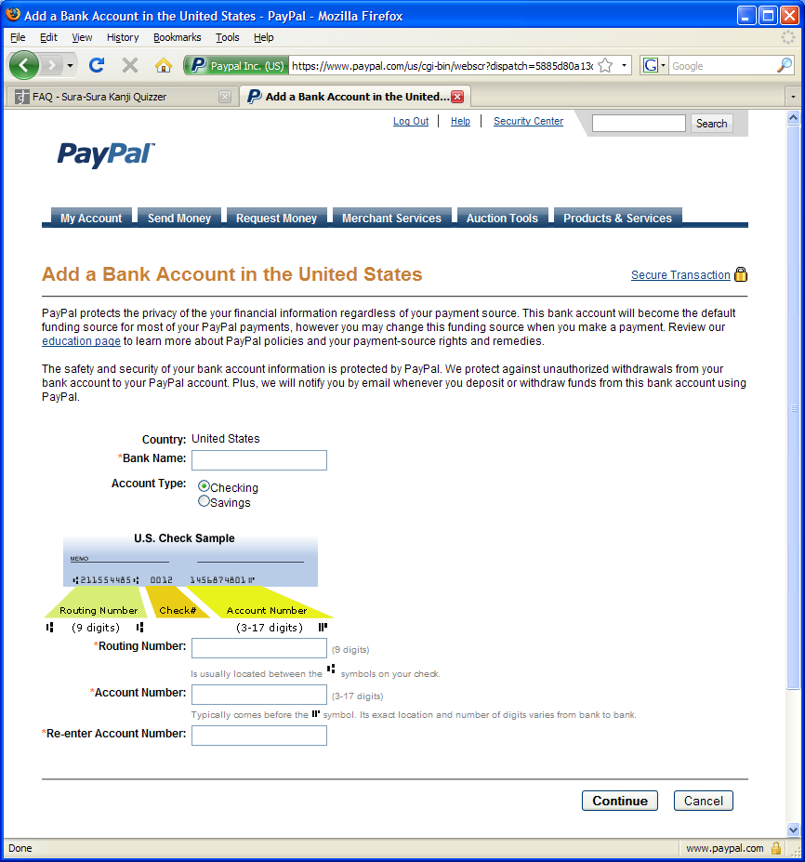
Payments Login CSRF

Slide 23
Login CSRF

Slide 24
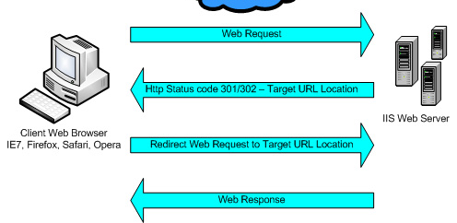
Sites can redirect browser

Slide 25
Attack on origin/referer header
referer: http://www.site.com
referer: http://www.site.com
What if honest site sends POST to attacker.com?
Solution: origin header records redirect

Slide 26
CSRF Recommendations
Login CSRF
Strict Referer/Origin header validation
Login forms typically submit over HTTPS, not blocked
HTTPS sites, such as banking sites
Use strict Referer/Origin validation to prevent CSRF
Other
Use Ruby-on-Rails or other framework that implements secret token method correctly
Origin header
Alternative to Referer with fewer privacy problems
Sent only on POST, sends only necessary data
Defense against redirect-based attacks

